Slide 1
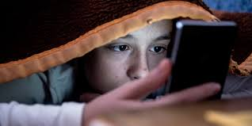
Impact of social media influencers
-By
Group 12
Sanjay
Anirudh
Shoban
Jaisurya
Kritika

Slide 2
Introduction
What: We have created a survey titled “Impact of social media influencer” in Google form and circulated it.
Why: We hoped to find out the level of impact of influencers, whether it is positive or negative, and how we could direct it towards public health.
How: We took the results from the survey, and used Excel to analyse it and PowerPoint to depict it.

Slide 3
Data
Since we have only taken categorical data: nominal data(Gender, section) as well as ordinal data (everything else) we have only analysed the data using mode, skewness and kurtosis.
We have received 112 responses.

Slide 4
Data analysis
General question 1: What Section are you from?
Code | Section | Number
1 | A | 19
2 | B | 32
3 | Others | 59
Mode = 3

Slide 5
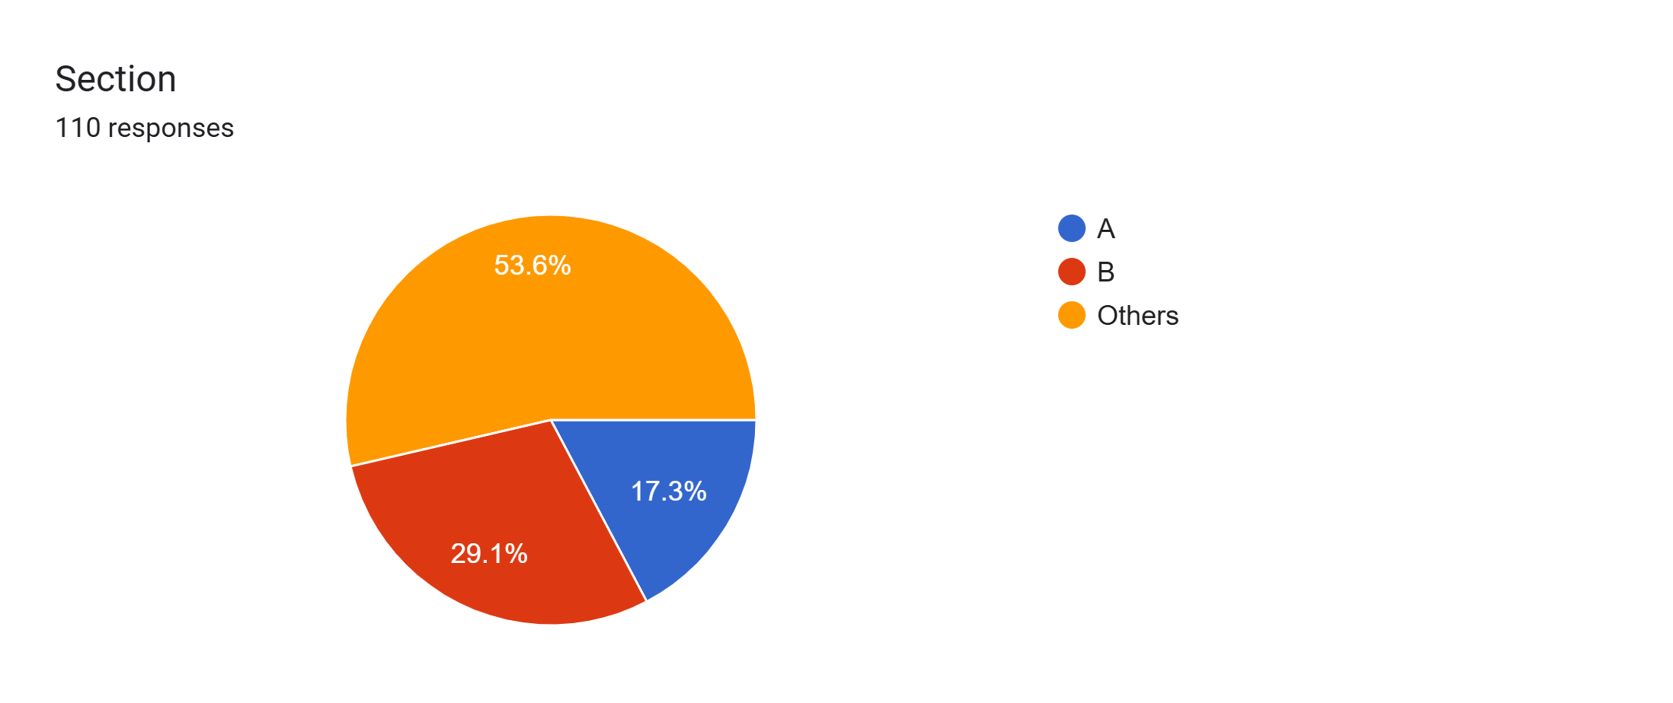

Slide 6
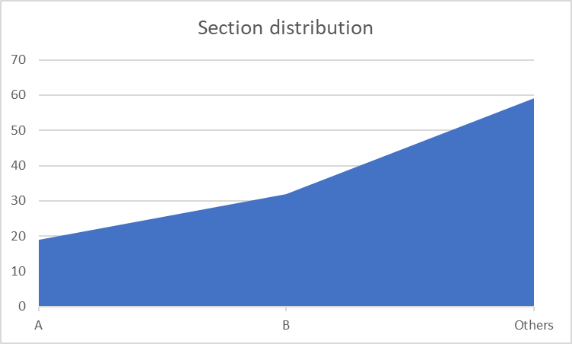
Skewness: -0.91249
Kurtosis: -0.72604

Slide 7
Inference: Most of the survey results come from people outside of our sections.
Insight: Most students/young people do not like filling forms and would rather spend time on Instagram.
Recommendation: We would recommend offering incentives to students to fill the form or just circulate it to older people.

Slide 8
General question 2: What is your gender?
Code | Gender | Number
1 | Male | 59
2 | Female | 41
3 | Transgender | 0
Mode = 1

Slide 9
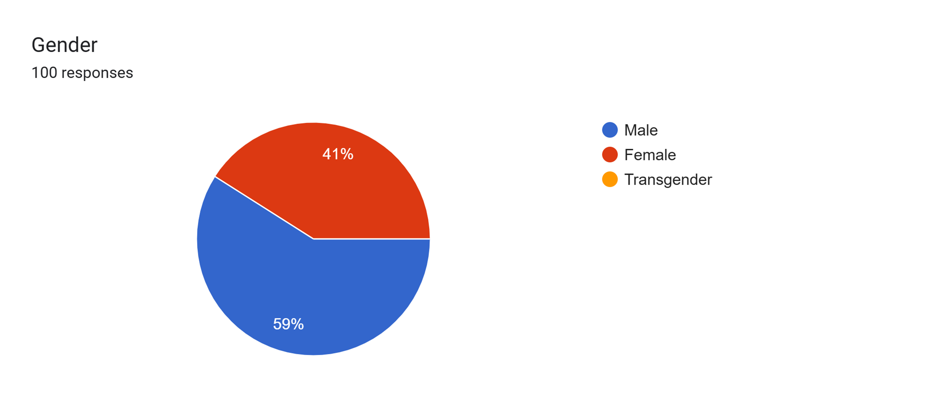

Slide 10
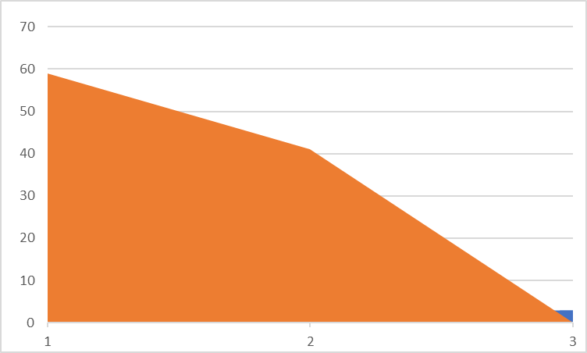
Kurtosis -1.900351094
Skewness 0.371574663

Slide 11
Inference: Most response are from male humans.
Insight: All 4 of us are boys so our friends are mostly male.
Recommendation: We should talk to more girls.

Slide 12
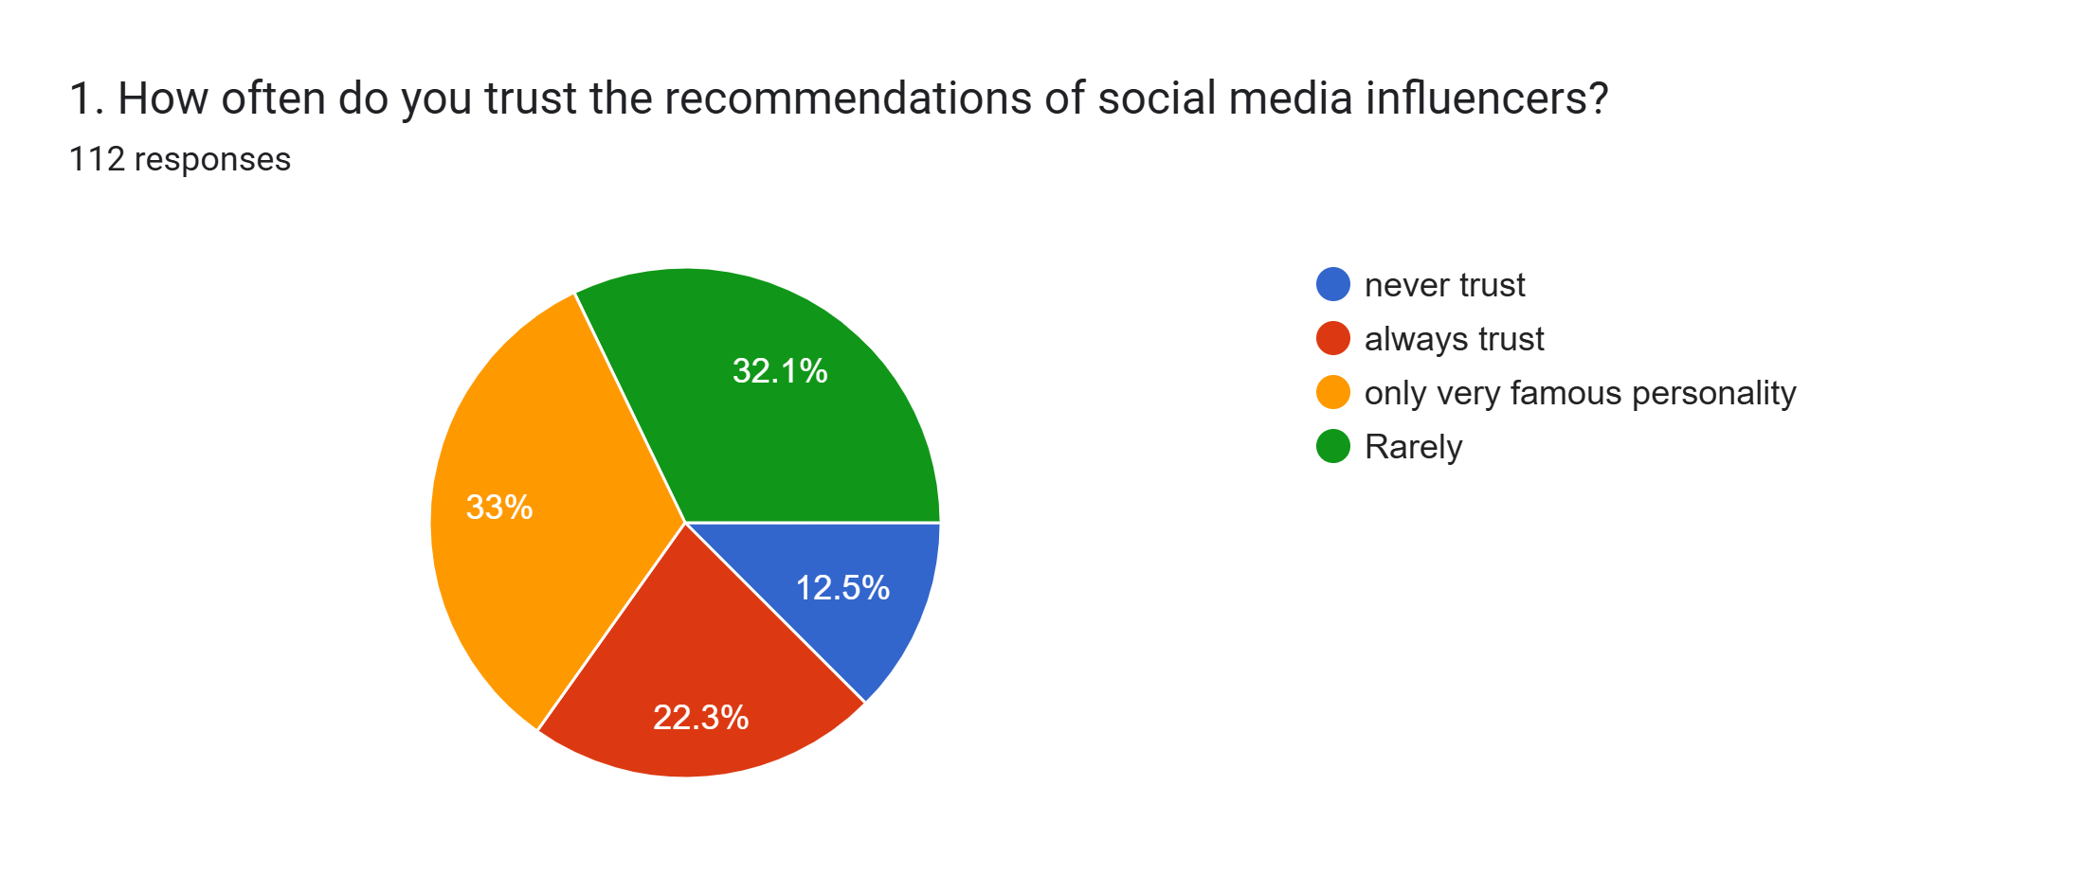
1. How often do you trust the recommendations of social media influencers?
Statement | code | Numbers
Never trust | 1 | 14
always trust | 2 | 25
only very famous personality | 3 | 37
rarely | 4 | 36
Mode = 3

Slide 13
skewness | -0.809431287
Kurtosis | -1.462285714

Slide 14
Inference:
People seem to correlate the level of trust they place in an influencer with their fame. Only well-known personalities are likely to be trusted widely. This suggests that micro-influencers or lesser-known influencers may struggle with building trust.
With a large number of respondents leaning toward "rarely trust" or "only trust very famous personalities," there is an opportunity for influencers, especially those not as famous, to work on building credibility through transparency, expertise, or by providing more authentic content.
Recommendation:
Influencers should focus on being transparent about product placements, sponsorships, and endorsements. By sharing more personal stories, real-life examples, and offering genuine advice, they can increase trust among skeptical audiences.
For audiences that rarely or never trust influencers, brands and influencers should use data driven content and real customer testimonials to boost the perception of authenticity. Focus on delivering value rather than pure promotion to build trust over time.

Slide 15
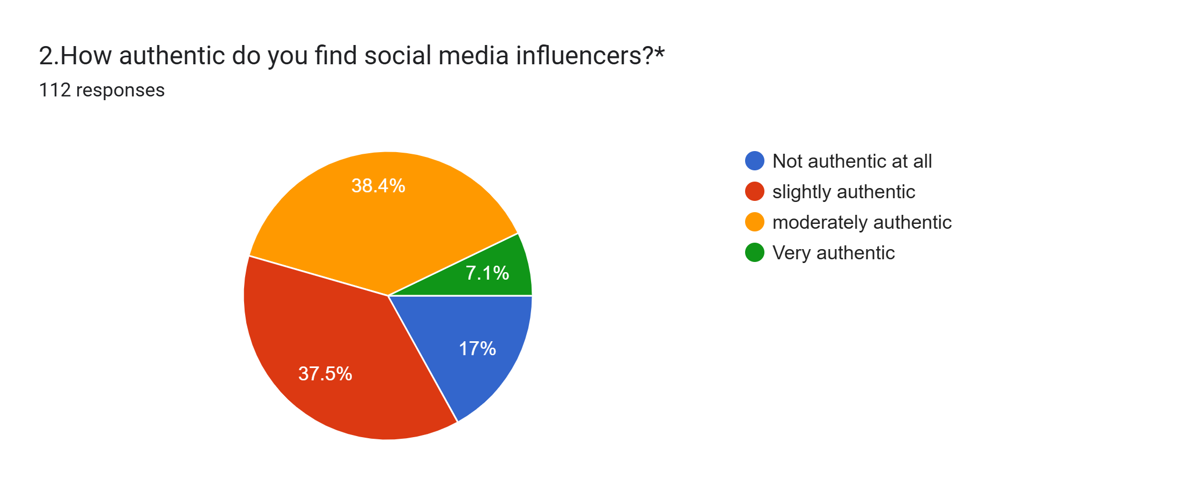
2.How authentic do you find social media influencers?
Statement | Code | Numbers
Not authentic at all | 1 | 19
Slighly authentic | 2 | 42
Moderately authentic | 3 | 43
Very authentic | 4 | 8
Mode = 3

Slide 16
Skewness | -0.333750038
Kurtosis | -4.075193829

Slide 17
Inference:
Influencers struggle with maintaining a high level of perceived authenticity. While many are viewed as moderately authentic, the large number of respondents rating them as only slightly authentic or not authentic at all suggests that audiences often doubt the genuineness of their endorsements or content.
Since Moderately authentic option is the mode, it shows that audience necessarily dismiss influencers entirely but don’t place them at the highest level of trust either. They perceive influencers as somewhat trustworthy, but they are aware of the potential commercial or strategic motives behind their recommendations.
Recommendation:
Influencers should focus on being transparent about their partnerships and financial relationships. Clearly disclosing sponsorships, product placements, or paid collaborations can build trust and help audiences differentiate between genuine recommendations and commercial content.
Consistency is key to building long-term authenticity. Influencers should consistently engage with their audience, provide value, and avoid promoting products that don’t align with their values or expertise, as inconsistent behavior can foster distrust.

Slide 18
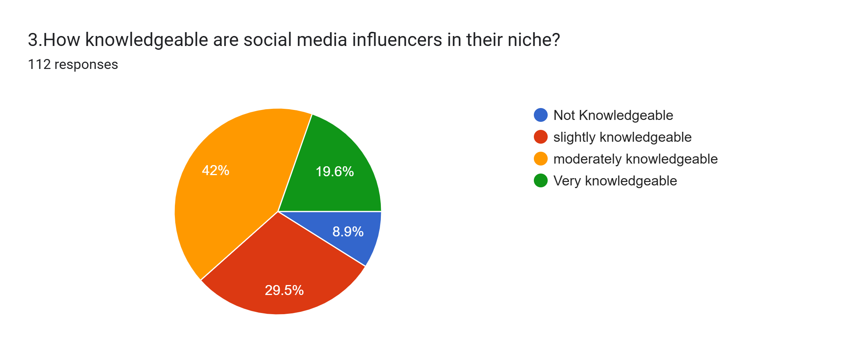
3. How knowledgeable are social media influencers in their niche?
Statement | Code | Numbers
Very Knowledgeable | 1 | 22
Moderately Knowledgeable | 2 | 47
Slightly Knowledgeable | 3 | 33
Not Knowledgeable | 4 | 10

Slide 19
skewness | 0.15913226
kurtosis | -0.712335315

Slide 20
Inference:
Since the majority of respondents see influencers as moderately knowledgeable, this implies that influencers are perceived to have a broad understanding of their niche but may not dive deeply into specialized knowledge. Audiences might appreciate influencers for their general insights but may not turn to them for in-depth expertise.
The fact that a large number of respondents rated influencers are slightly knowledgeable indicates that influencers may not always be seen as reliable sources of expert knowledge. This could be due to the perception that influencers prioritize engaging content over deep research and expertise
Recommendation:
Influencers can collaborate with experts in their niche to bolster their credibility. For example, partnering with professionals, researchers, or industry leaders can add depth to their content, making them more trustworthy as knowledgeable figures.
Influencers should clarify when their content is entertainment-focused versus when it is knowledge-based. This differentiation will allow them to manage audience expectations. Influencers who focus solely on entertainment may not be expected to deliver deep insights, while those aiming to be industry experts should emphasize content depth.
Instead of trying to cover a wide array of topics, influencers should consider focusing on a specific niche within their industry. Becoming an authority in a specialized area can boost their credibility as knowledgeable figures, as the audience may perceive them as more focused and in-depth in their content.

Slide 21
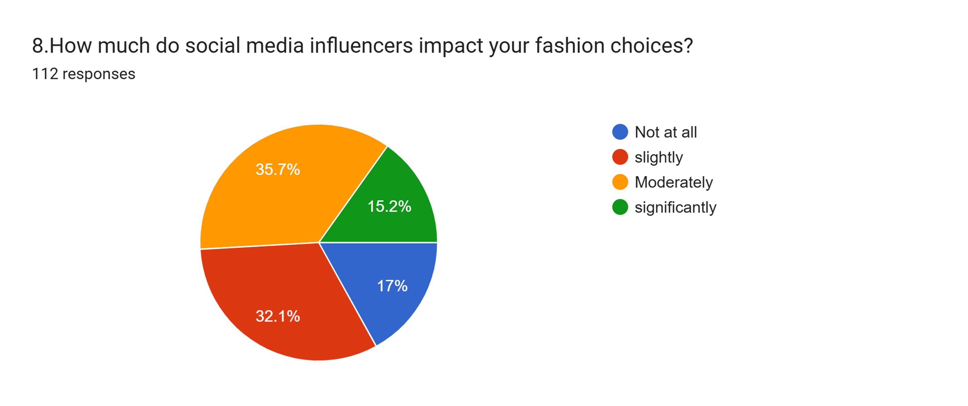

Slide 22
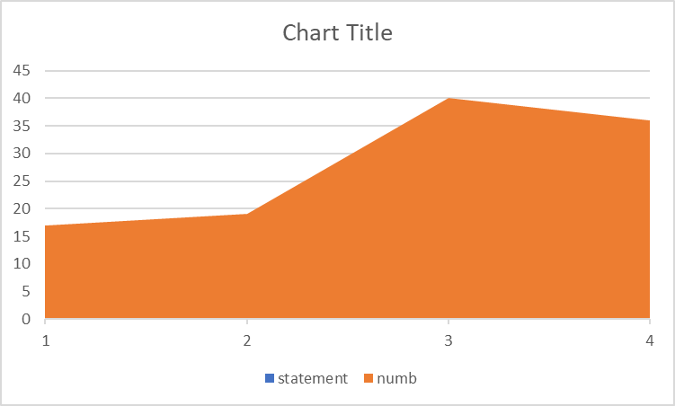
skewness -0.51771073 kurtosis -0.888527296

Slide 23
Inference A significant portion of respondents (40%) report a moderate impact of social media influencers on their fashion choices. Insight: there is a notable proportion of people who either experience significant influence or none at all. Recommendation: They should consider whether these trends genuinely suit their style and needs, rather than following them blindly.

Slide 24
8.How much do social media influencers impact your fashion choices?
Code | statement | numb
`1 | Significantly | 17
2 | Not at all | 19
3 | Moderately | 40
4 | Slightly | 36
Mode = 3

Slide 25
9.How often do you follow health and fitness advice from social media influencers?
Statement | Numbers
rarely | 15
Sometimes | 36
Often | 27
Always | 24
never | 10
Mode = 2

Slide 26
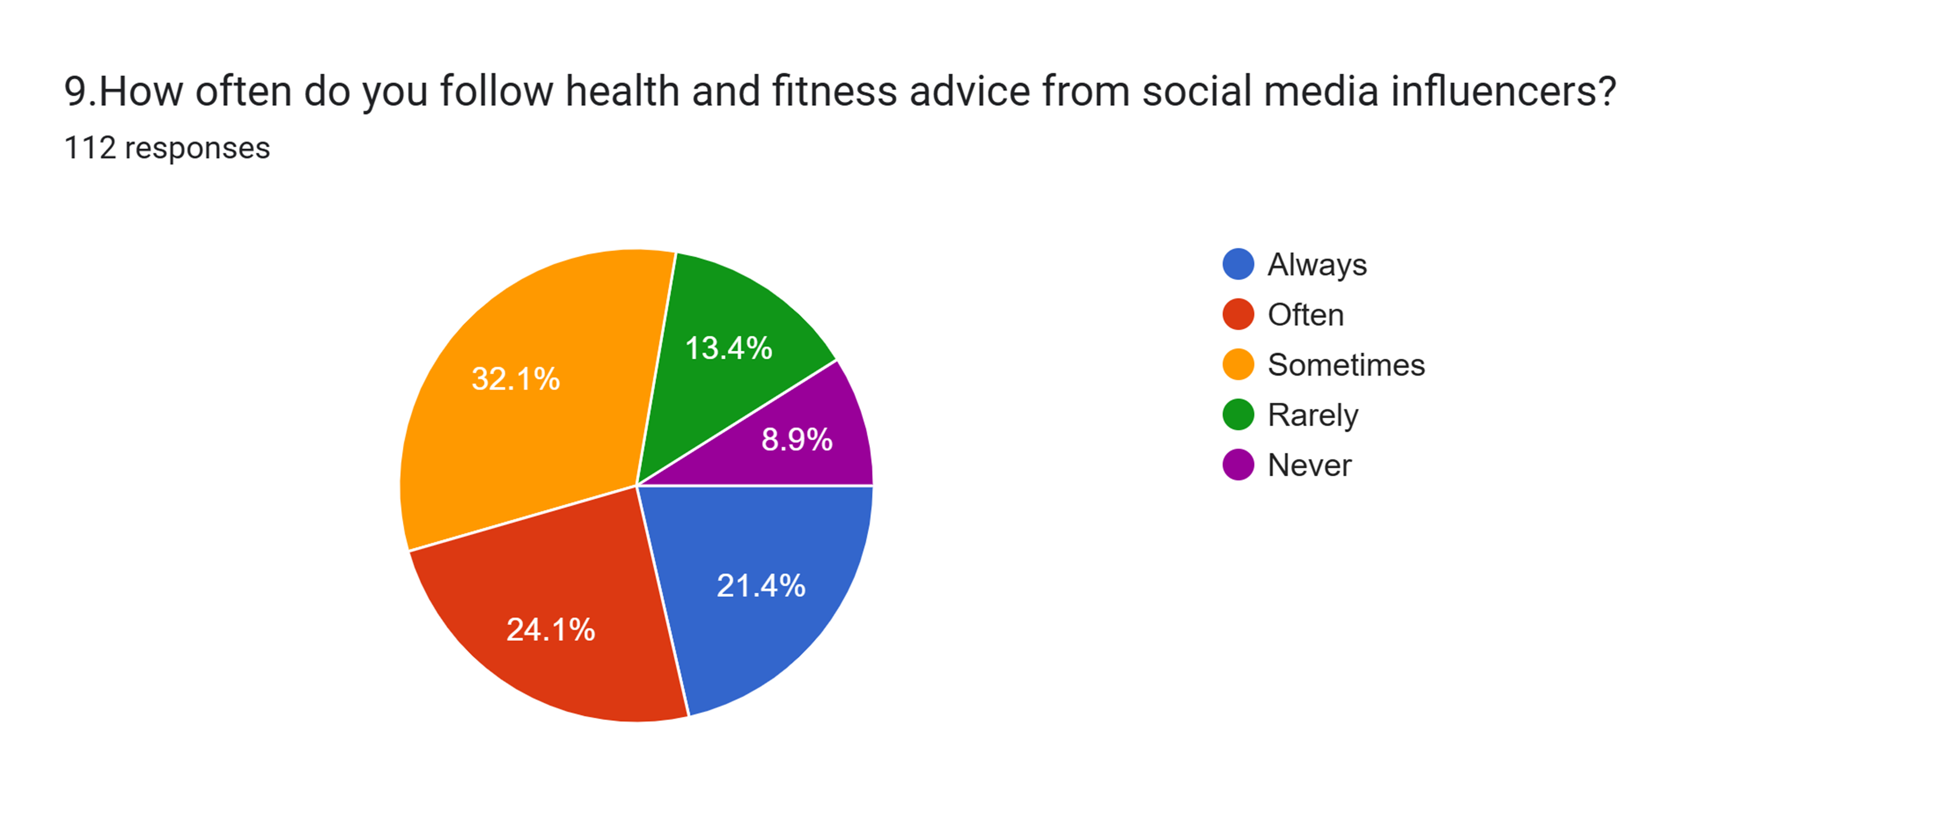

Slide 27
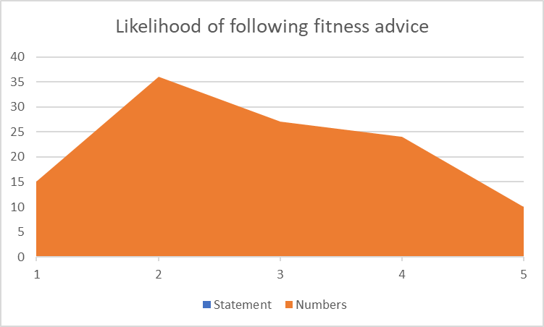
Skewness 0.224151336 positive skew Kurtosis -0.879862884 platykurtic

Slide 28
Inference About half of the respondents follow this advice either "often" or "always" (51%).
Insights: The fact that a sizable portion follows advice only "sometimes" or "often" rather than "always" implies that while influencers are influential, their advice is not always taken as gospel.
Consider adopting a balanced approach by integrating social media advice with professional guidance.

Slide 29
10. How much do social media influencers impact your beauty and skincare routine? 1
Code | statement | numb
1 | Moderately | 39
2 | Not at all | 19
3 | Significantly | 18
4 | slightly | 36
Mode = 1

Slide 30
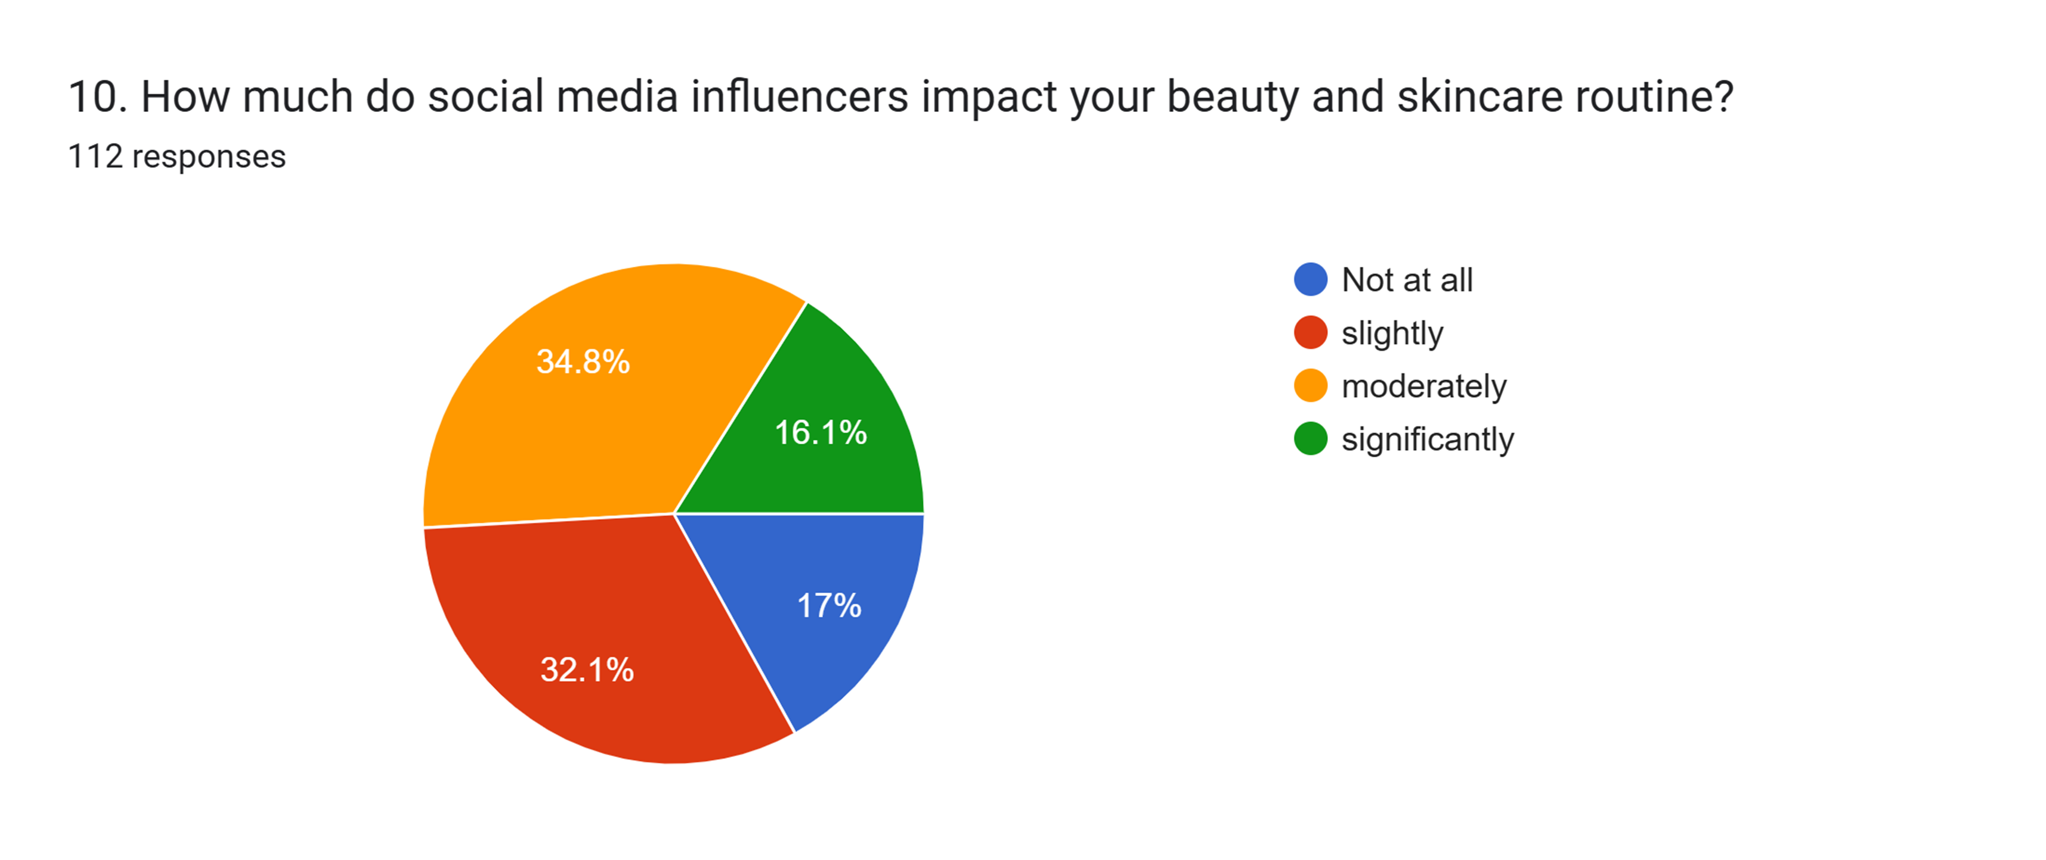

Slide 31
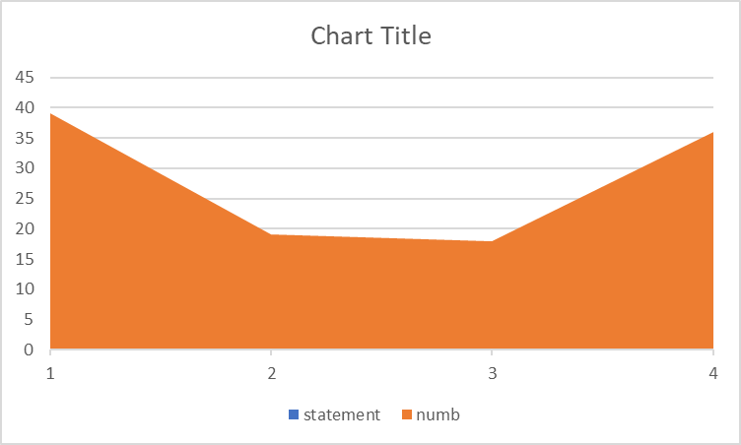
skewness 0.061409206 kurtosis -1.66555473

Slide 32
Inference The largest portion of respondents (39%) indicates that social media influencers impact their beauty and skincare routine “moderately.” Insight Social media influencers have a varied impact on beauty and skincare routines, with the majority experiencing moderate to slight influence. Recommendation: Encourage individuals to approach beauty and skincare advice from influencers with a critical eye.

Slide 33
11. How often do you choose travel destinations based on social media influencers' recommendations?
Code | Statement | Numberes
1 | Often | 15
2 | Sometimes | 53
3 | Rarely | 31
4 | Never | 13
Mode = 2

Slide 34
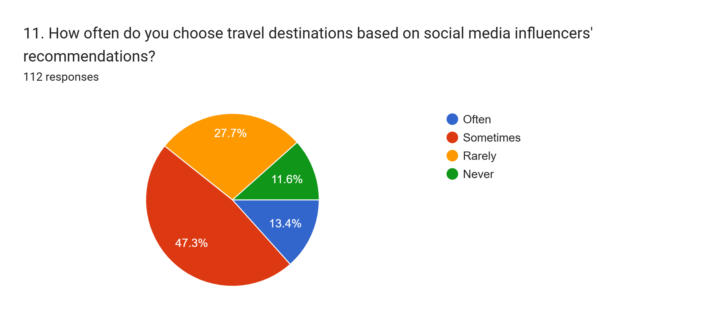

Slide 35
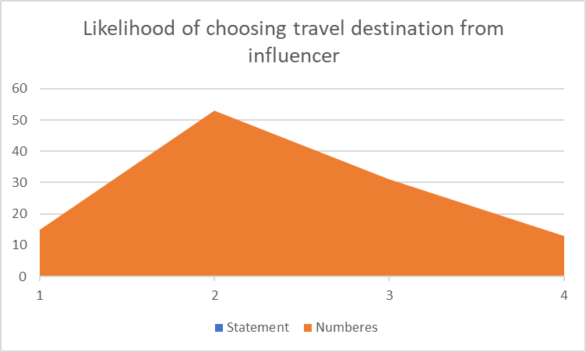
Kurtosis -0.484191115
Skewness 0.310085943

Slide 36
Inference: Influencers have a moderate impact on destination choices
Insight: People might need additional confirmation from friends, relatives or reviews before choosing.
Recommendation: Influencers can involve random people visiting and ask their opinions, can collaborate with local tourist agencies.

Slide 37
12. How much do social media influencers influence your dining choices?
Code | Statement | Numbers
1 | Not at all | 18
2 | Slightly | 41
3 | Moderately | 35
4 | Significantly | 18
Mode = 2

Slide 38


Slide 39
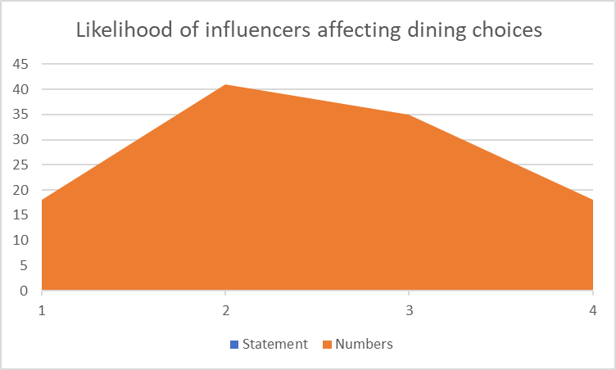
Kurtosis -0.884189227
Skewness 0.07820346

Slide 40
Inference: Majority sample have slight influence on dining choices.
Insight: Second biggest chose moderate, overall people are willing to choose dining choices based on influencers.
Recommendation: Influencers could help restaurants give feedback from customers on food choices.

Slide 41
13. How often do you follow technology and gadget recommendations from social media influencers? .
Code | Statement | Numbers
1 | Often | 12
2 | Sometimes | 56
3 | Rarely | 34
4 | Never | 10
Mode = 2

Slide 42
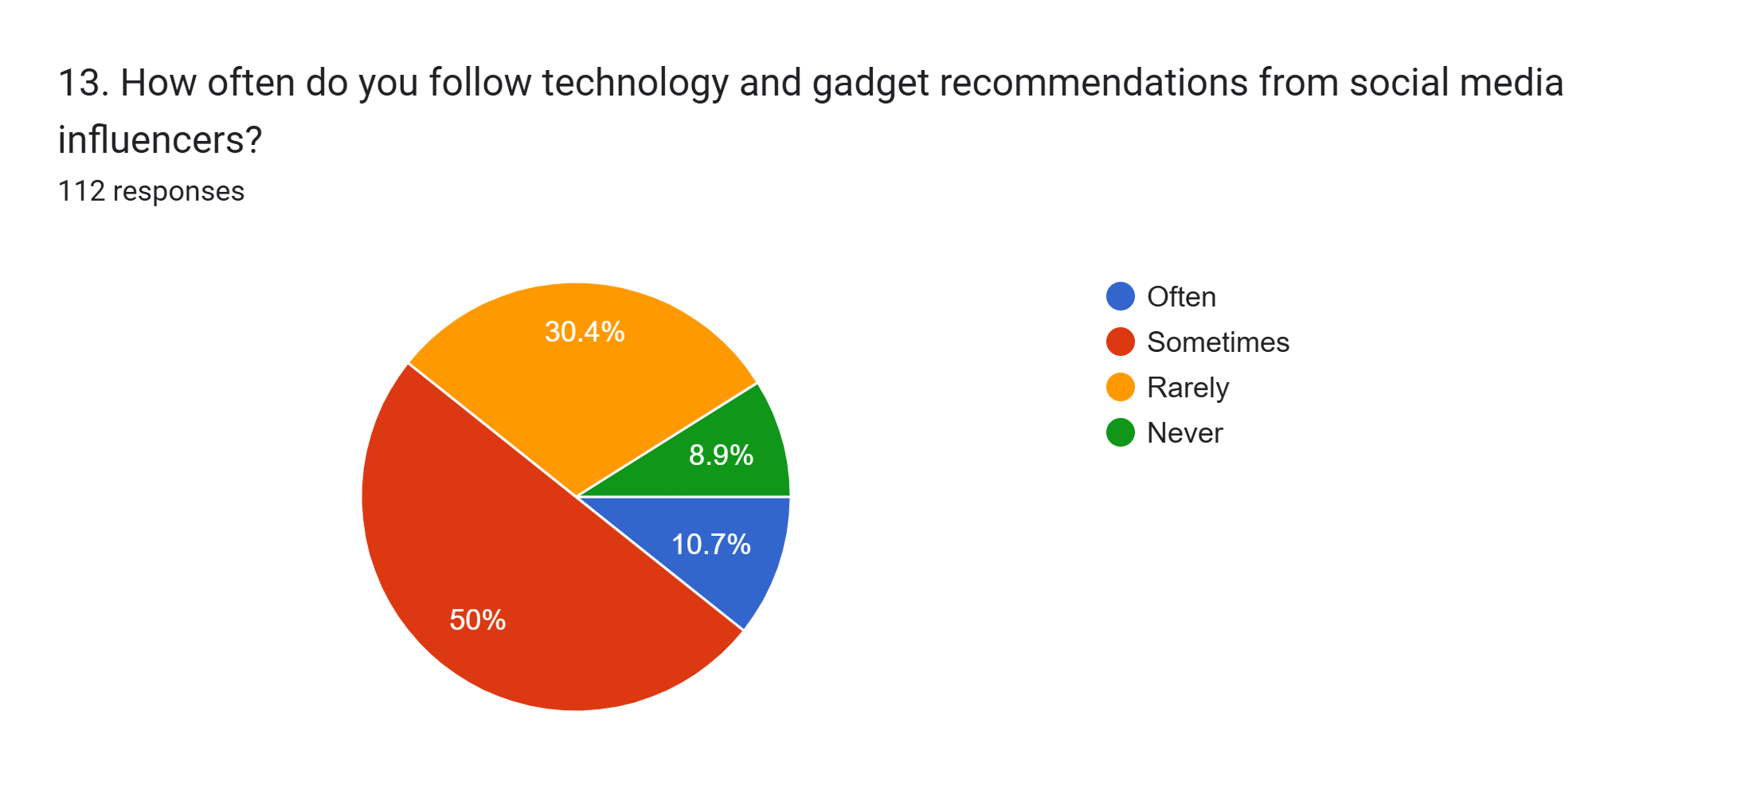

Slide 43

Kurtosis -0.259531635
Skewness 0.310856533

Slide 44
Inference: 50% of sample listens to influencer recommendations sometimes.
Insights: Lots of people have chosen rarely and never, maybe most influencers lack expertise.
Recommendations: Would recommend to collaborate with technical social media people or engineers.

Slide 45
14. How much do social media influencers impact your entertainment choices (movies, music, etc.)?
Code | Statement | Numbers
1 | Not at all | 18
2 | Slightly | 35
3 | Moderately | 38
4 | Significantly | 21
Mode = 3

Slide 46
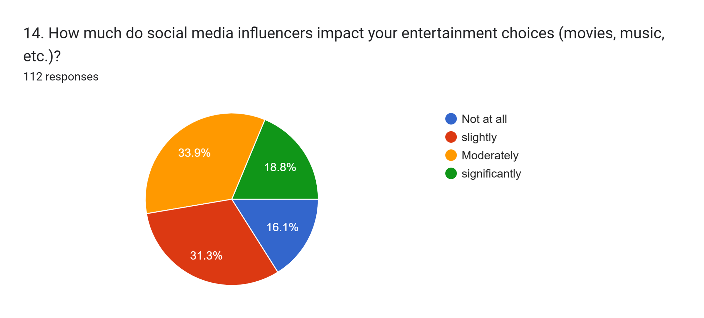

Slide 47
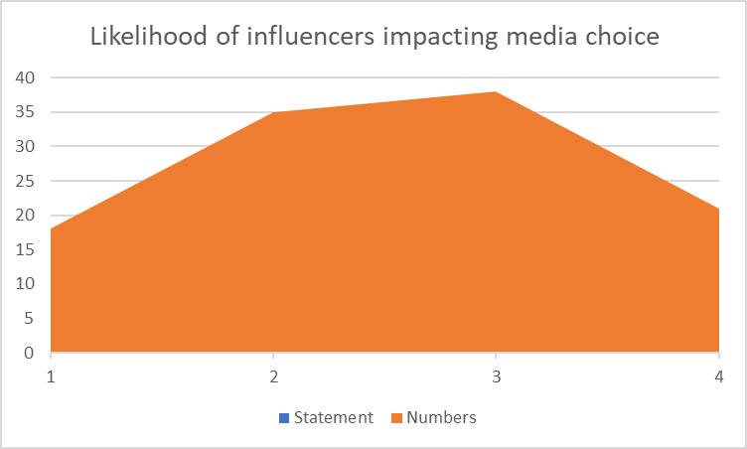
Kurtosis -0.968075754
Skewness -0.064195561

Slide 48
Inference: Most people have chosen moderate influence on media choices.
Insight: The reason might be that personal tastes of audience do not match with the influencers’ tastes.
Recommendations: Influencers can involve people with different media tastes, so they can attract wide audience.

Slide 49
15. Overall, how influential are social media influencers in your daily life ?
Code | Statement | Numbers
1 | Not influential | 23
2 | Slightly influential | 46
3 | Moderately influential | 35
4 | Very influential | 8
Mode = 2

Slide 50
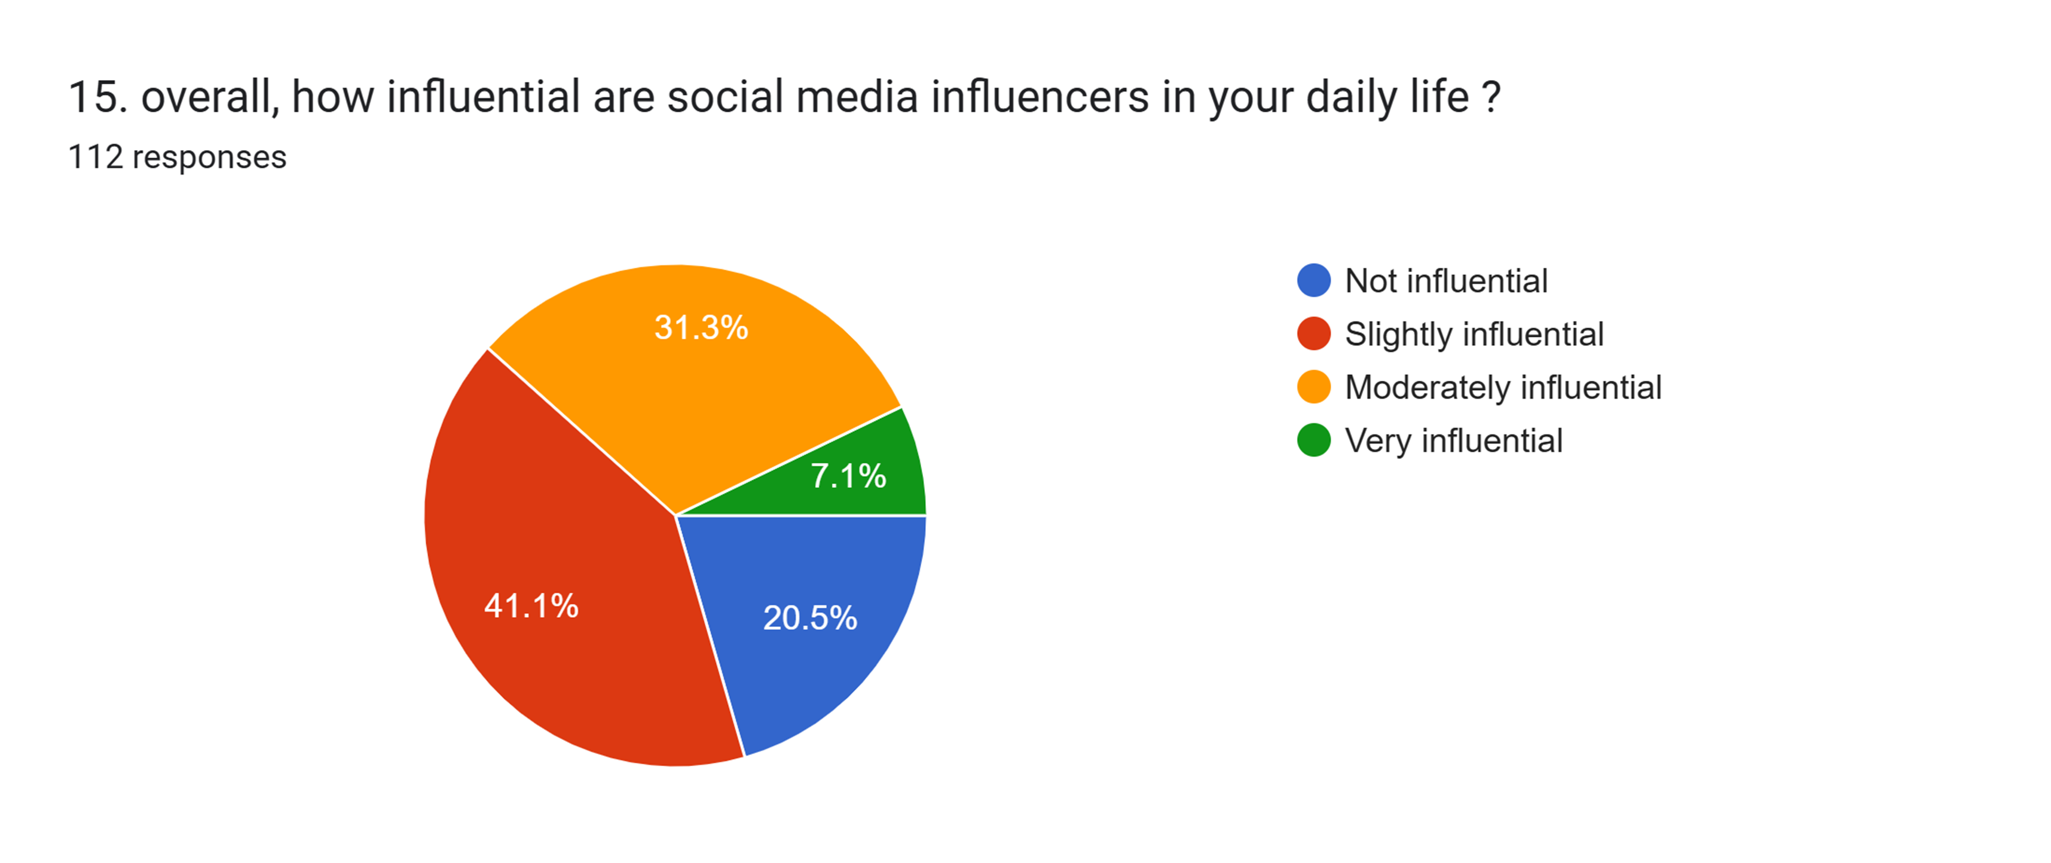

Slide 51
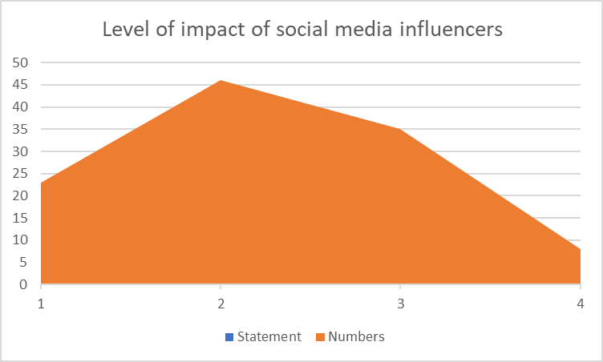
Skewness 0.170235815
Kurtosis -0.660293168

Slide 52
Inferences: The people have said that they are slightly-moderately influenced.
Insights: 20.5% of the sample has chosen zero influence, might be due to personality differences.
Recommendations: Would recommend influencers to be transparent, truthful, and not promote harmful products.

Slide 53
Improvements measures, addition of new questions
Collect the data sooner
Could have asked numerical data
Could have done other types of analyses that I do not know yet
Could have created better charts that represents the data more accurately

Slide 54
Mistakes done
Created a survey called “Artificial Intelligence impact on future”. Maybe too complicated, only got 40 responses after 20 days.
Collected data too late.
Could have started sooner, rushed it a little bit.
Did numerical analyses for categorical data at first, removed it after ma’am had mentioned it.

Slide 55
Conclusion
Most have chosen slight influence over moderate, and no influence over high influence. I would conclude that people are quite sceptical about social media influencers.
Thank you.

